Slide 1

Chapter 13 – System Implementation
Version 2 – 18th December 2015

Slide 2

Modern Systems Analysis and Design
Ninth Edition, Global Edition
Chapter 13
System Implementation
Copyright © 2020 Pearson Education Ltd.
Notes:
If this PowerPoint presentation contains mathematical equations, you may need to check that your computer has the following installed:
1) MathType Plugin
2) Math Player (free versions available)
3) NVDA Reader (free versions available)

Slide 3
Learning Objectives
13.1 Provide an overview of the system implementation process
13.2 Describe how software applications are tested
13.3 Apply four installation strategies: direct, parallel, single-location, and phased installation
13.4 List the deliverables for documenting the system and for training and supporting users
13.5 Explain why system implementation sometimes fails
13.6 Describe the threats to system security and remedies that can be applied
13.7 Show how traditional implementation issues apply to electronic commerce applications

Slide 4
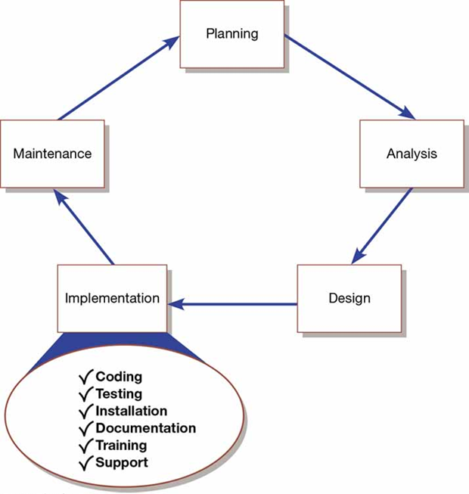
Figure 13-1: Systems Development Life Cycle with the Implementation Phase Highlighted

Slide 5
System Implementation
13.1 Provide an overview of the system implementation process
Purpose:
To convert final physical system specifications into working and reliable software
To document work that has been done
To provide help for current and future users

Slide 6
Table 13-1: Deliverables for Coding, Testing, and Installation
Coding
a. Code
b. Program documentation
Testing
a. Test scenarios (test plan) and test data
b. Results of program and system testing
Installation
a. User guides
b. User training plan
c. Installation and conversion plan
Software and hardware installation schedule
Data conversion plan
Site and facility remodeling plan

Slide 7
Documenting the System, Training Users, and Supporting Users
13.1 Provide an overview of the system implementation process
Two audiences for final documentation:
Information systems personnel who will maintain the system throughout its productive life
People who will use the system as part of their daily lives
User Training
Application-specific
General for operating system and off-the-shelf software

Slide 8
Table 13-2: Deliverables for Documenting the System, Training and Supporting Users
Documentation
a. System documentation
b. User documentation
User training plan
a. Classes
b. Tutorials
User training modules
a. Training materials
b. Computer-based training aids
User support plan
a. Help desk
b. Online help
c. Bulletin boards and other support mechanisms

Slide 9
Software Application Testing
13.2 Describe how software applications are tested
A master test plan is developed during the analysis phase
During the design phase, unit, system and integration test plans are developed
The actual testing is done during implementation
Written test plans provide improved communication among all parties involved in testing

Slide 10
Table 13-3: Table of Contents of a Master Test Plan (1 of 3)
13.2 Describe how software applications are tested
Introduction
a. Description of system to be tested
b. Objectives of the test plan
c. Method of testing
d. Supporting documents
Overall Plan
a. Milestones, schedules, and locations
b. Test materials
Test plans
Test cases
Test scenarios
Test log

Slide 11
Table 13-3: Table of Contents of a Master Test Plan (2 of 3)
13.2 Describe how software applications are tested
Testing Requirements
a. Hardware
b. Software
c. Personnel
Procedure Control
a. Test initiation
b. Test execution
c. Test failure
d. Access/change control
e. Document control

Slide 12
Table 13-3: Table of Contents of a Master Test Plan (3 of 3)
13.2 Describe how software applications are tested
Test-specific or component-specific test plans
a. Objectives
b. Software description
c. Method
d. Milestones, schedule, progression
e. Locations
f. Requirements
g. Criteria for passing tests
h. Resulting test materials
i. Execution control
j. Attachments
(Source: Adapted from Mosley, 1993.)

Slide 13
Seven Different Types of Tests (1 of 4)
13.2 Describe how software applications are tested
Software application testing is an umbrella term that covers several types of tests
Static or dynamic techniques
Static testing means that the code being tested is not executed
Dynamic testing involves execution of the code
Automated testing versus manual testing
Automated means computer conducts the test
Manual means that people complete the test

Slide 14
Table 13-4: Categorization of Test Types
Blank | Manual | Automated
Static | Inspections | Syntax checking
Dynamic | Walk-through Desk checking | Unit test Integration test System test
(Source: Adapted from Mosley, 1993)

Slide 15
Seven Different Types of Tests (2 of 4)
13.2 Describe how software applications are tested
Seven types of testing:
Inspections – testing technique in which participants examine program code for predictable language-specific errors
Walk-throughs (code walk-throughs) should be done frequently when pieces of work are reviewed and before formal testing. It is an informal process.

Slide 16
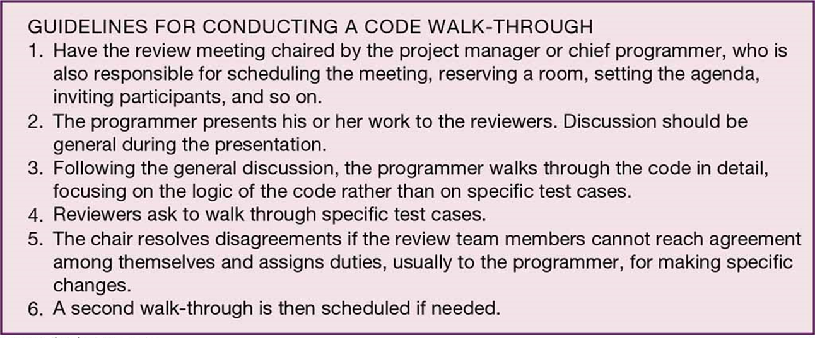
Figure 13-2: Steps in a Typical Walk-Through
(Source: Based on Yourdon, 1989)

Slide 17
Seven Different Types of Tests (3 of 4)
13.2 Describe how software applications are tested
Seven types of testing:
Desk checking – testing technique in which the program code is sequentially executed manually by the reviewer
Unit testing – process of testing each module alone in an attempt to discover any errors in its code
Integration testing – process of bringing together all of the modules that a program comprises for testing purposes. Modules are typically integrated in a top-down, incremental fashion.

Slide 18
Seven Different Types of Tests (4 of 4)
13.2 Describe how software applications are tested
Seven types of testing:
System testing – bringing together of all of the programs that a system comprises for testing purposes. Programs are typically integrated in a top-down, incremental fashion.
Stub testing – technique used in testing modules, especially where modules are written and tested in a top-down fashion, where a few lines of code are used to substitute for subordinate modules

Slide 19
The Testing Process (1 of 2)
13.2 Describe how software applications are tested
Two important things to remember when testing information systems:
The purpose of testing is to confirm that the system satisfies requirements
Testing must be planned
A test case is a specific scenario of transactions, queries, or navigation paths that represent a typical, critical, or abnormal use of the system
Should be repeatable
Need to determine if new software work with other existing software

Slide 20
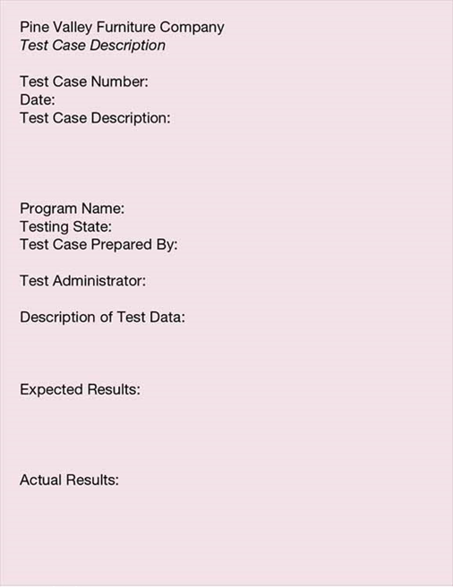
Figure 13-3: Test Case Description Form
(Source: Adapted from Mosley, 1993)

Slide 21
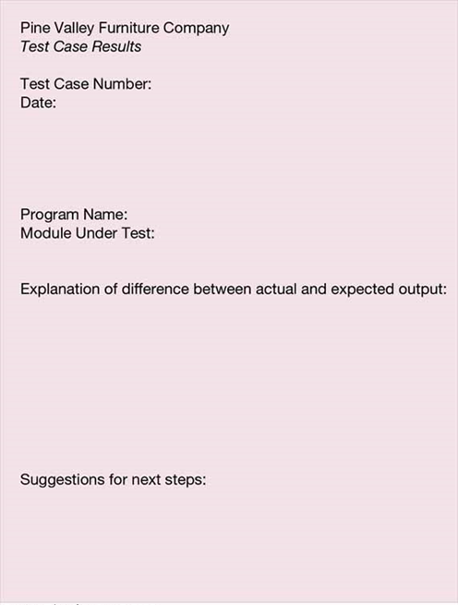
Figure 13-4: Test Case Results Form
(Source: Adapted from Mosley, 1993)

Slide 22
The Testing Process (2 of 2)
13.2 Describe how software applications are tested
Testing harness – automated testing environment used to review code for errors, standards violations, and other design flaws
Greatly enhances the testing process because it can automatically expand the scope of the tests beyond the current development platform

Slide 23
Combining Coding and Testing
13.2 Describe how software applications are tested
Coding and testing are part of the same process
Big companies and big projects often have dedicated testing staffs
Refactoring – making a program simpler after adding a new feature
eXtreme programming is a technique used in refactoring

Slide 24
Acceptance Testing by Users (1 of 2)
13.2 Describe how software applications are tested
Acceptance testing – process whereby actual users test a completed information system, the end result of which is the users’ acceptance of it
Alpha testing – user testing of a completed information system using simulated data
Beta testing – user testing of a completed information system using real data in the real user environment

Slide 25
Acceptance Testing by Users (2 of 2)
13.2 Describe how software applications are tested
Tests performed during alpha testing:
Recovery testing—forces the software (or environment) to fail in order to verify that recovery is properly performed
Security testing—verifies that protection mechanisms built into the system will protect it from improper penetration
Stress testing—tries to break the system (e.g., what happens when a record is written to the database with incomplete information or what happens under extreme online transaction loads or with a large number of concurrent users)
Performance testing—determines how the system performs in the range of possible environments in which it may be used (e.g., different hardware configurations, networks, operating systems, and so on); often the goal is to have the system perform with similar response time and other performance measures in each environment

Slide 26
Installation (1 of 5)
13.3 Apply four installation strategies: direct, parallel, single-location, and phased installation
Installation – organizational process of changing over from the current information system to a new one
Four installation strategies:
Direct installation
Parallel installation
Single-location installation
Phased installation

Slide 27
Installation (2 of 5)
13.3 Apply four installation strategies: direct, parallel, single-location, and phased installation
Direct installation – changing over from the old information system to a new one by turning off the old system when the new one is turned on
Users at the mercy of the new system
Very risky installation
Least expensive installation

Slide 28
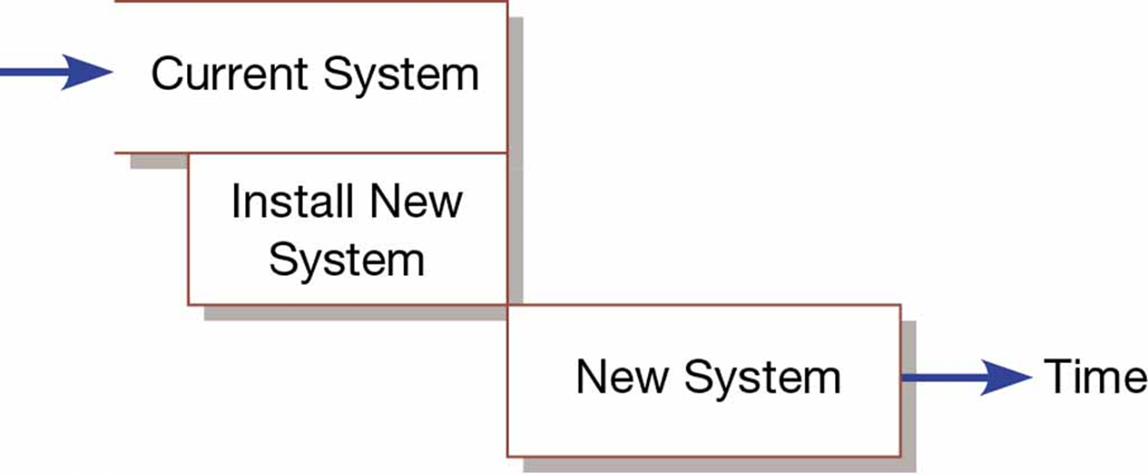
Figure 13-5: Comparison of Installation Strategies (a) Direct Installation
(Source: Adapted from Bell and Evans, 1989)

Slide 29
Installation (3 of 5)
13.3 Apply four installation strategies: direct, parallel, single-location, and phased installation
Parallel installation – running the old information system and the new one at the same time until management decides the old system can be turned off
Safest approach but very expensive
Outputs are compared with each system

Slide 30
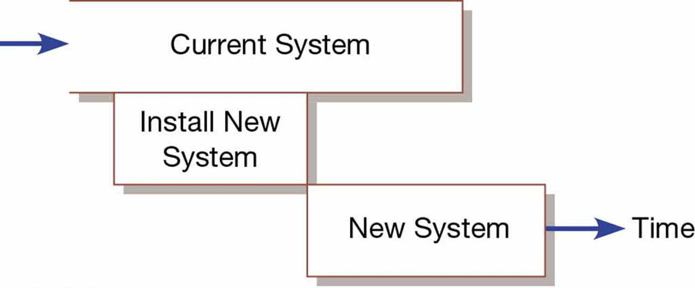
Figure 13-5: Comparison of Installation Strategies (b) Parallel Installation
(Source: Adapted from Bell and Evans, 1989)

Slide 31
Installation (4 of 5)
13.3 Apply four installation strategies: direct, parallel, single-location, and phased installation
Single-location installation – trying out a new information system at one site and using the experience to decide if and how the new system should be deployed throughout the organization
Considered a middle-or-the-road approach
Usually a branch office or one department
Once successful then rolled out to entire company
Results in extra work for staff

Slide 32
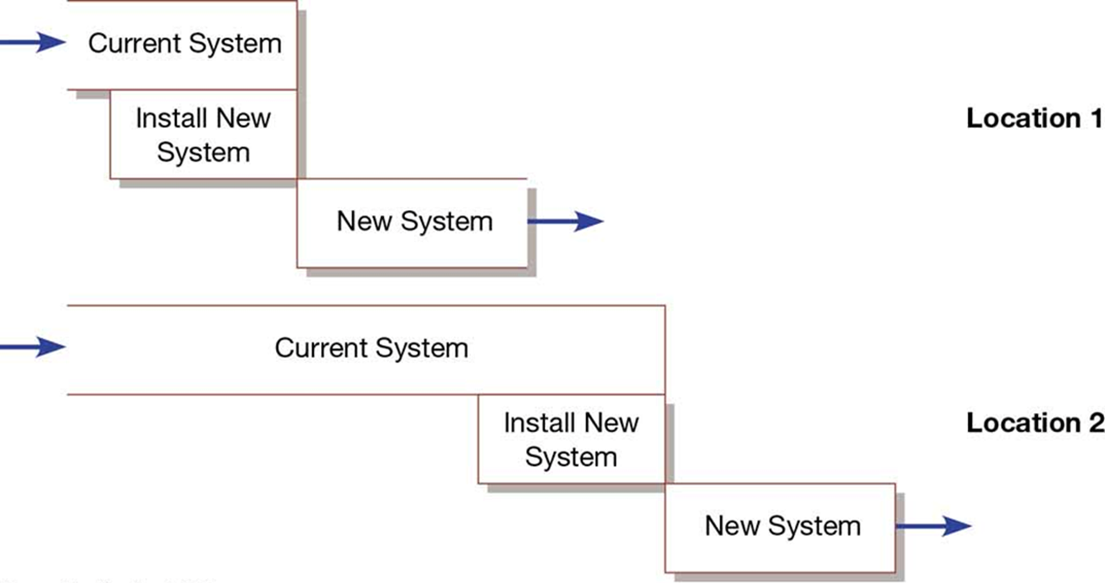
Figure 13-5: Comparison of Installation Strategies (c) Single-Location Installation (with Direct Installation at Each Location)
(Source: Adapted from Bell and Evans, 1989)

Slide 33
Installation (5 of 5)
13.3 Apply four installation strategies: direct, parallel, single-location, and phased installation
Phased installation – changing from the old information system to the new one incrementally, starting with one or a few functional components and then gradually extending the installation to cover the whole new system
An incremental approach (also called staged)
Usually implemented in a sequence approach
Requires careful version control

Slide 34
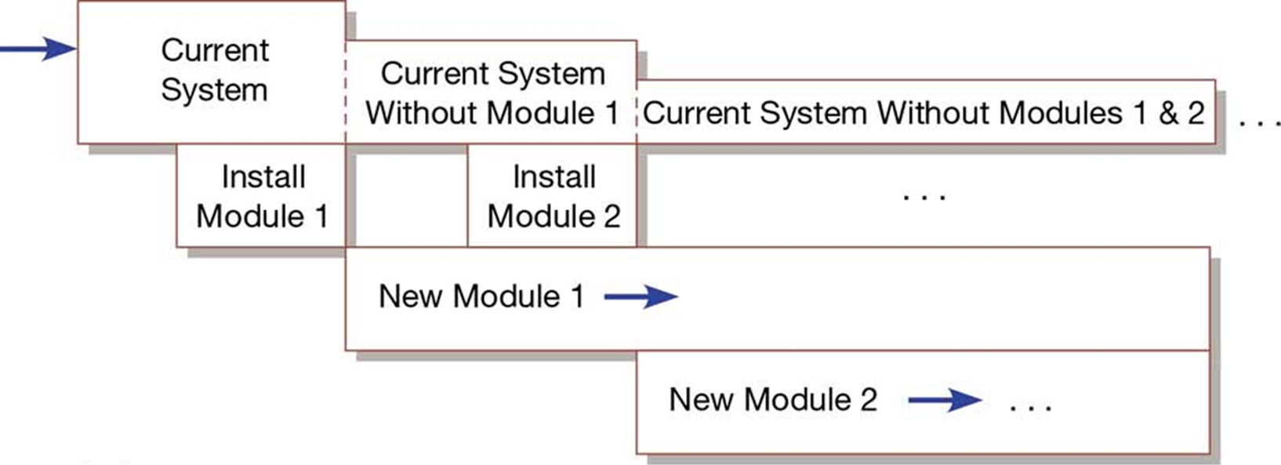
Figure 13-5: Comparison of Installation Strategies (d) Phased Installation
(Source: Adapted from Bell and Evans, 1989)

Slide 35
Planning Installation
13.3 Apply four installation strategies: direct, parallel, single-location, and phased installation
Of special interest during installation is the conversion of data
Must be error free, combined with new data and loaded into files
May require current systems to be shut down
Involves getting people to change the way they work

Slide 36
Documenting the System
13.4 List the deliverables for documenting the system and for training and supporting users
System documentation – detailed information about a system’s design specifications, its internal workings, and its functionality
User documentation – written or other visual information about an application system, how it works, and how to use it

Slide 37
Table 13-5: S D L C and Generic Documentation Corresponding to Each Phase
Generic Life-Cycle Phase | Generic Document
Requirements Specification | System Requirements Specification Resource Requirements Specification
Project Control Structuring’ | Management Plan Engineering Change Proposal
System Development: Architectural design Prototype design Detailed design and implementation Test specification Test implementation | Architecture Design Document Prototype Design Document Detailed Design Document Test Specifications Test Reports
System Delivery | User’s Guide Release Description System Administrator’s Guide Reference Guide Acceptance Sign-Off
(Source: Adapted from Bell & Evans, 1989)

Slide 38
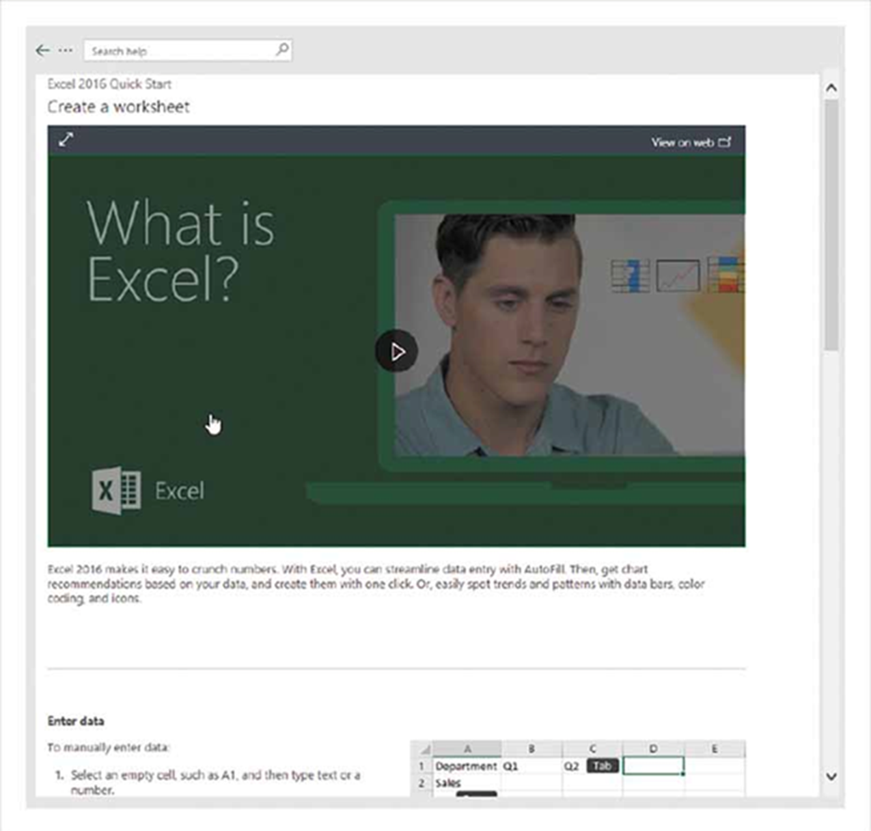
Figure 13-7: A Quick Start Guide for Excel
(Source: Microsoft Corporation)

Slide 39
Table 13-6: Outline of a Generic User’s Guide (n = Many Different Sections)
Preface
Introduction
1.1. Configuration
1.2. Function flow
2. User Interface
2.1. Display screens
2.2. Command types
Getting started
3.1. Login
3.2. Logout
3.3. Save
3.4 Error recovery
3.n [Basic procedure name]
n. [Test name]
Appendix A—Error Messages
([Appendix])
Glossary
Terms
Acronyms
Index
(Source: Adapted from Bell & Evans, 1989)

Slide 40
Training and Supporting Users
13.4 List the deliverables for documenting the system and for training and supporting users
Support – providing ongoing educational and problem-solving assistance to information system users. For in-house developed systems, support materials and jobs will have to be prepared or designed as part of the implementation process.

Slide 41
Training Information System Users
13.4 List the deliverables for documenting the system and for training and supporting users
Potential training topics include:
Use of the system (e.g., how to enter a class registration request)
General computer concepts (e.g., computer files and how to copy them)
Information system concepts (e.g., batch processing)
Organizational concepts (e.g., F I F O inventory accounting)
System management (e.g., how to request changes to a system)
System installation (e.g., how to reconcile current and new systems during phased installation)

Slide 42
Table 13-7: Types of Training
Resident expert
Traditional instructor-led classroom training
E-learning/distance learning
Blended learning (combination of instructor-led and e-learning)
Software help components
External sources, such as vendors

Slide 43
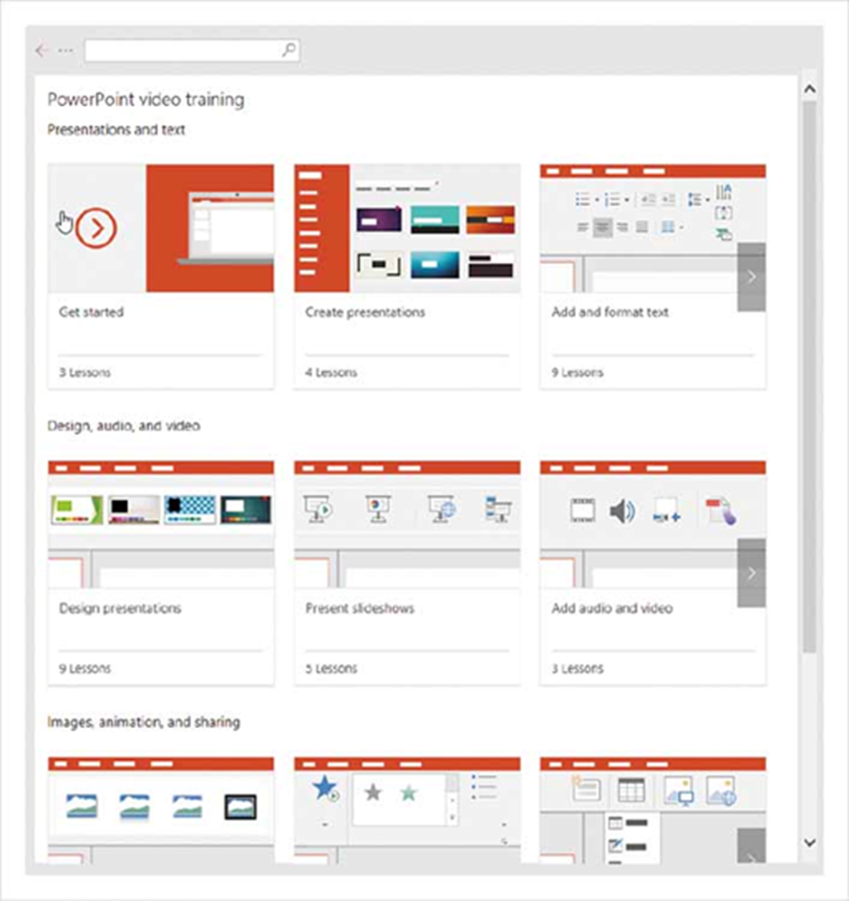
Figure 13-8: E-learning Resources Available for PowerPoint 2016
(Source: Microsoft Corporation)

Slide 44
Supporting Information Systems Users
13.4 List the deliverables for documenting the system and for training and supporting users
Support is important to users, but has often been inadequate for users’ needs
Users consider support to be extremely important
Increased need for support came from lack of standards governing client/server products

Slide 45
Automating Support
13.4 List the deliverables for documenting the system and for training and supporting users
Vendor’s have automated support to users in order to cut costs
Ways vendor’s have automated support:
Forums offered over the Internet
Voice-response systems allow users to navigate option menus
Vendor knowledge bases
Help desk – single point of contact for all user inquiries and problems about a particular information system or for all users in a particular department (non automated)

Slide 46
Organizational Issues in Systems Implementation
13.5 Explain why system implementation sometimes fails
Implementation effort sometimes fails because:
Employees don’t use the new system
Employee dissatisfaction with new system
Important factors to implementation success include:
Commitment to the project
Commitment to change (willingness to change behaviors)
Meeting user expectations

Slide 47
Factors Influencing System Use
13.5 Explain why system implementation sometimes fails
Six factors that influenced the extent to which a system is used:
User’s personal stake
System characteristics
User demographics
Organizational support
Performance
Satisfaction

Slide 48
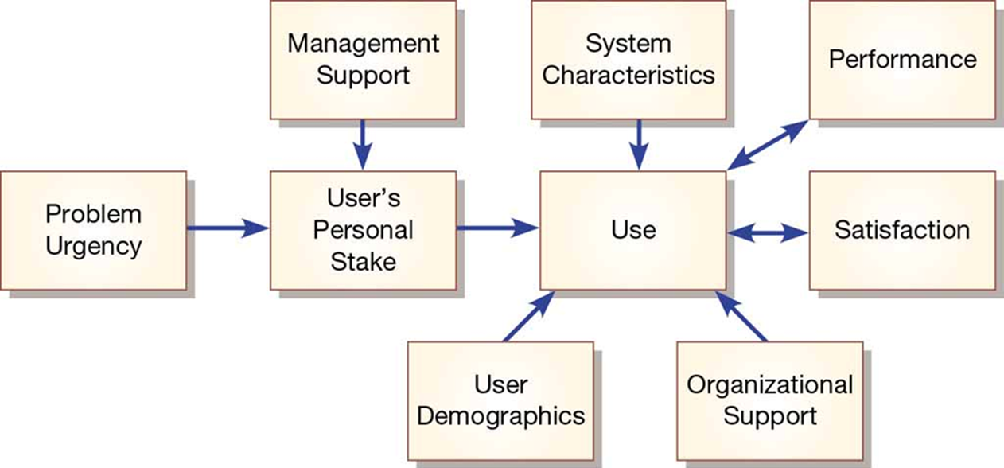
Figure 13-9: Implementation Success
(Source: From Lucas, H. C. (1997). Information technology for management. New York: McGraw-Hill. Reprinted by permission.)

Slide 49
Security Issues
13.6 Describe the threats to system security and remedies that can be applied
Increasingly important issue for organizations and their management
Malicious software (malware): includes Trojan horses, worms, viruses, and other kinds
External sources of threats include laptop theft, system penetration, and denial of service
Weakest link: the user!
Failure to use (or secure) passwords

Slide 50
Developing Test Cases for the WebStore
13.7 Show how traditional implementation issues apply to electronic commerce applications
Developing test cases for the WebStore include testing categories as follows:
Simple functionality
Multiple functionality
Function chains
Elective functions
Emergency/crisis

Slide 51
WebStore Test Cases
13.7 Show how traditional implementation issues apply to electronic commerce applications
Case documentation test form sections include:
Test Case I D
Category/Objective of Test
Description
System Version
Completion Date
Participant(s)
Machine Characteristics (processor, operating systems, memory, browser, etc.)
Test Result
Comments

Slide 52
Bug Tracking and System Evolution
13.7 Show how traditional implementation issues apply to electronic commerce applications
Sections of the bug tracking form:
Bug Number (simple incremental number)
Test Case I D That Generated the Bug
Is the Bug Replicable?
Effects
Description
Resolution
Resolution Date
Comments

Slide 53
Alpha and Beta Testing the WebStore
13.7 Show how traditional implementation issues apply to electronic commerce applications
Alpha Testing:
P V F employees who actively participated received a t-shirt and $100 to shop
Development team conducted extensive recovery, security, stress, and performance testing
Beta Testing
P V F recruited several of their established customers to help in beta testing

Slide 54
Table 13-9: Sample of Tests Conducted on the WebStore During Alpha Testing
Test Type | Tests Performed
Recovery | Unplug main server to test power backup system Switch off main server to test the automatic switching to backup server
Security | Try to purchase without being a customer Try to examine server directory files both within the P V F domain and when connecting from an outside Internet service provider
Stress | Have multiple users simultaneously establish accounts, process purchases, add to shopping cart, remove from shopping cart, and so on
Performance | Examine response time using different connection speeds, processors, memory, browsers, and other system configurations Examine response time when backing up server data

Slide 55
Project Closedown
13.7 Show how traditional implementation issues apply to electronic commerce applications
Closing down the project:
Evaluate team members
Reassign, terminate members as needed
Conduct post project reviews with users and customers
Close out customer contract

Slide 56
Summary
In this chapter you learned how to:
Provide an overview of the system implementation process
Describe how software applications are tested
Apply four installation strategies: direct, parallel, single-location, and phased installation
List the deliverables for documenting the system and for training and supporting users
Explain why system implementation sometimes fails
Describe the threats to system security and remedies that can be applied
Show how traditional implementation issues apply to electronic commerce applications

Slide 57

kent.edu.au Kent Institute Australia Pty. Ltd. ABN 49 003 577 302 ● CRICOS Code: 00161E ● RTO Code: 90458 ● TEQSA Provider Number: PRV12051

